Slide 1


FRAUDULENT CREDIT CARDS TRANSACTIONS
Boutique sales products Analysis
Group 5$
Prepared by: VERSAILLES Chrismond
VALCIN Pierry
RAPHAЁL Bony Alexandre

Slide 2
Introduction
The bank has been receiving several complaints about credit card frauds from their customers and the news media is regularly reporting about how the bank's customers are losing large amounts of money and the bank is doing nothing to stop it. This is impacting both the customers experience and their market share.
Our task is to find solutions to the problems encountered by the bank.

Slide 3
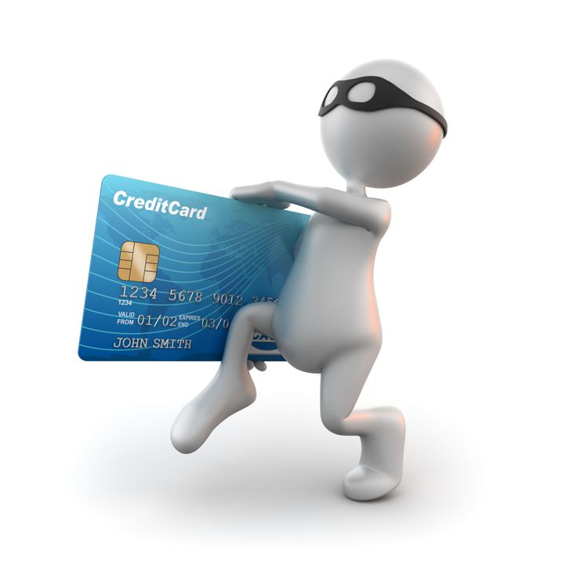
Problem
This problem is important for the bank in the sense that it has negative repercussions on the fiability of the company because to reach its first objective which is to offer the best service that possible to its customers since one does not manage to protect them from the risks of the fraudulent transactions made by credit card, moreover, its reputation and its customers are threatened, because the media denounce the inaction of the bank vis-a-vis such a situation.

Slide 4
Methodology
To realized this project, we used:
The bank Dataset
Data processing using Python 3
- Cleaning Data with pandas
- Data transformation with Pandas/numpy
- Statistical Analysis with seaborn/matplotlib
Results (Summary Statistics)
Slideshow made by Microsoft powerpoint
Two optimal solutions were found

Slide 5
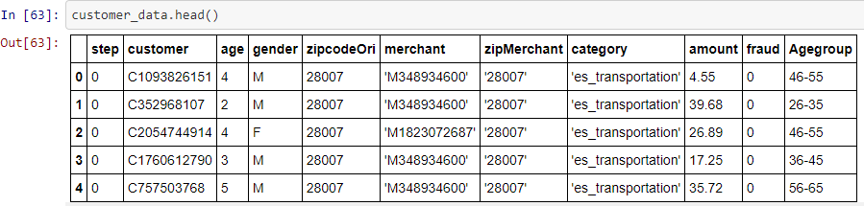
Let’s get a look at the dataset head.

Slide 6
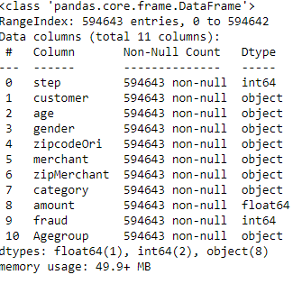
Informations about the dataset
In this dataset, we will have to work with 594643 observations of data, mostly informations about our customers including amount spent, category of transactions, age group and Fraud or not Fraud.
The customers type is Entreprise and particular, genders are Male and female

Slide 7
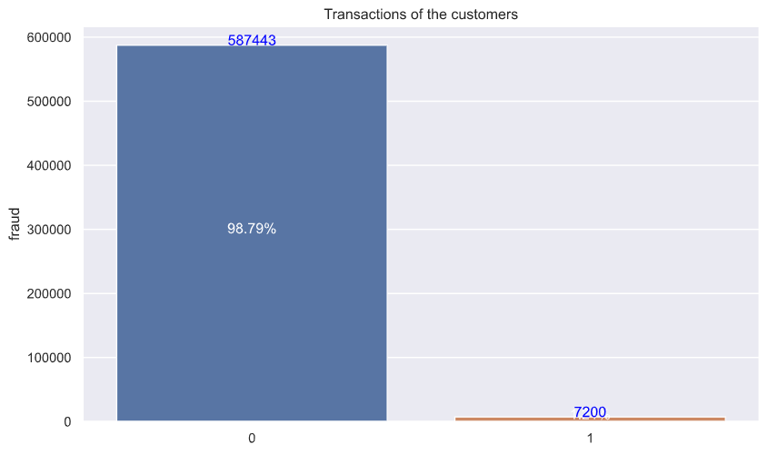
Summary of the transactions
This graph display the number of transactions that were fraud or not.
There was about 7200 fraudulent transactions during the past 6 months. It represents 1,2% of the total transactions
40 frauds transactions daily.

Slide 8
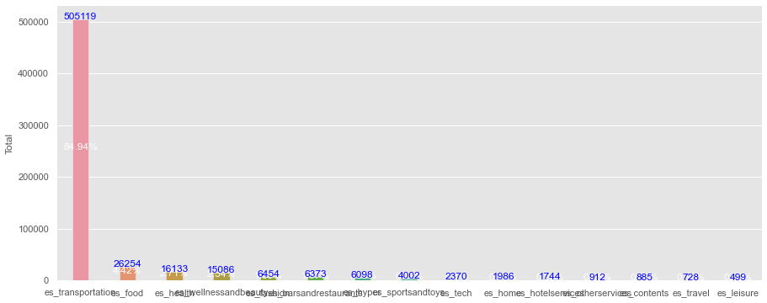
Summary of the transactions
84,94 % of the transactions made by the customers was in transportation category. Followed by food, but there was a huge gap between the transportation and the others category.

Slide 9
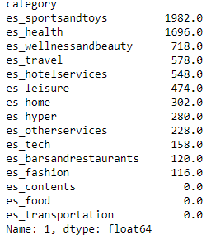
Summary of the fraudulent transactions
But the summary table of the fraudulent transactions shows us that Transportation and Food had no cases of fraudulent transactions .

Slide 10
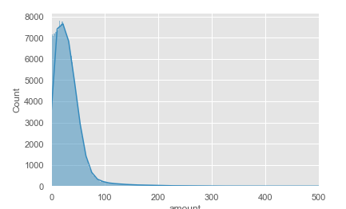
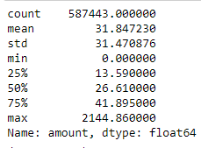
Summary of the transactions
The mean of the fraudulent transactions is near 1,21%.
The customers of the bank do not spent a lot of money, the mean of their transactions is 31.84 and 50% of the transactions didn’t exceed 26,61

Slide 11
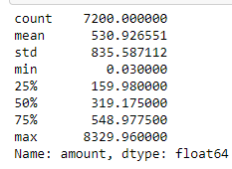
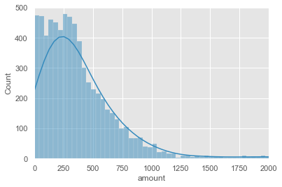
Summary of the fraudulent transactions
On the other hand, the fraudulent transactions are a lot of different than the normal transactions . The mean of the transactions is 530,92 and a std of 835,58. The fraudulent transactions tends to be higher than the non-frauds one.

Slide 12
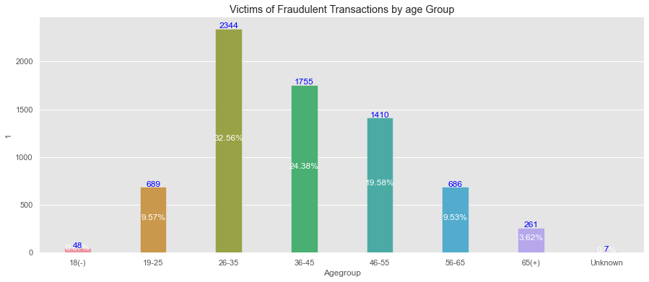
Victims of fraudulent transactions by Age group
The 26-35 age group is more victims of fraudulent transactions , followed by 36-45 age group.

Slide 13
Is there a Threshold for the transaction ?
With the insights provided by the analysis of the transactions, We can see there is a greater probability for a transaction that is upper than 50 $ to be fraudulent. Knowing that 75% of the non-fraudulents transactions don’t exceed 41,89.

Slide 14
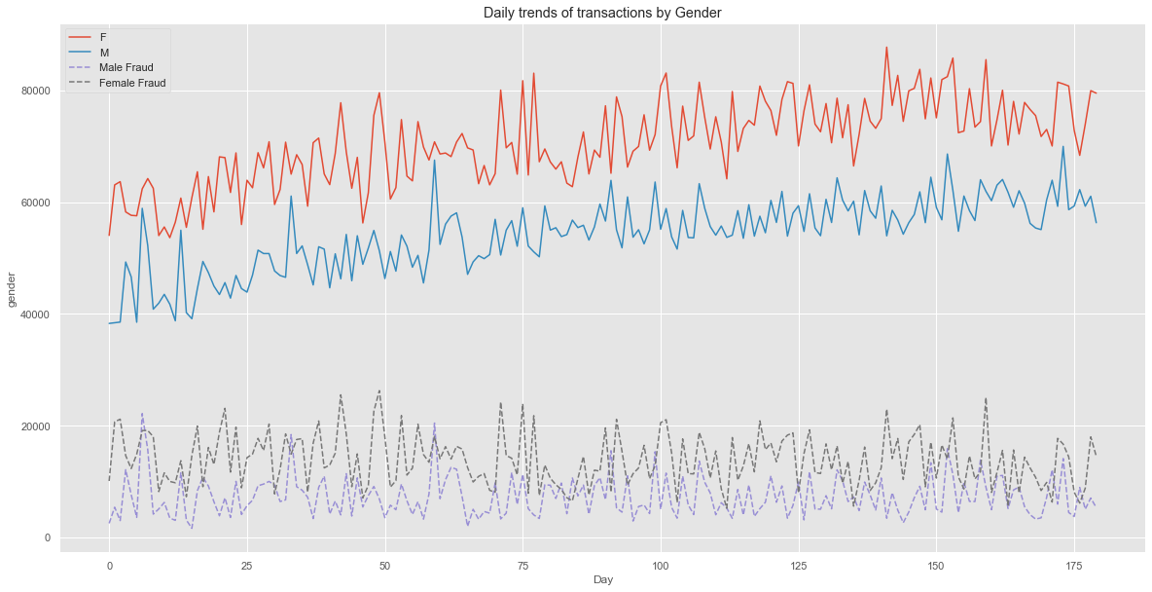
Daily trends of the transactions by Gender
By looking at this data , we can see that female tends to make more transactions daily than the male customers and they are also the ones that are more victims of fraud looking by this data.

Slide 15
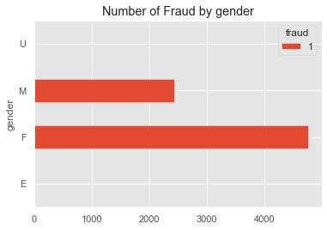
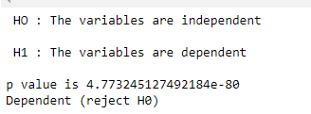
Gender with highest probability to be victim
In this graph, we can see that the females has a higher chance to be victims of fraud. We confirm it with a chi-square test to know if the gender and fraud variable are dependent. Using bayes formula, A customer victim of fraud has a 70,07 % to be a women

Slide 16
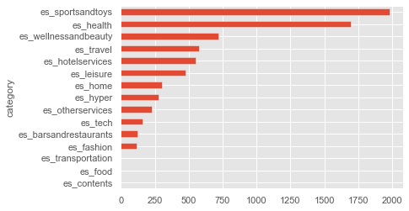
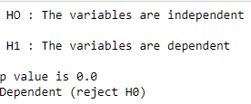
Category with the highest probability to be victim
In this graph, we can see that customer that buys sports and toys has a higher chance to be victims of fraud. We confirm it with a chi-square test to know if the category and fraud variable are dependent.

Slide 17
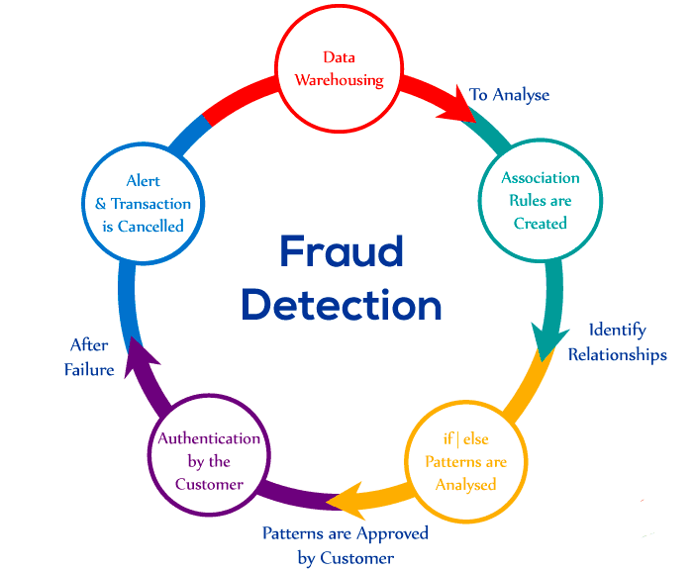
Discussion & Proposal Solutions
Solution 1: A machine learning model for fraud prediction.
- If the transaction has a probability of fraud ranging from 0 to 10%, it will go through without problem
- If this probability is between 10 and 60% it will report the card holder and ask for a with an OTP to process the transaction
- If it is over 60%, it will not even pass. The holder of the card has to process it manually

Slide 18
Discussion & Proposal Solutions
Solution 1: A machine learning model for fraud prediction.
Strength | Weakness
Speed Scale Efficiency | Lack of inspectability Cold start Blind to connections in data
Opportunities | Threats
Opportunity for the bank to be one step ahead of potential fraud cases. Opportunity for the bank to have a defense system that evolves and adapts to new types of fraud cases. | - There is always a risk that there will be fraud due to bias, the time it takes to adapt our program and the lack of human expertise.

Slide 19
Discussion & proposal solution
Solution 2: Optimize a highly secure mobile application and introduce a two-step authentication mechanism to ensure that each transaction originates from the card owner.
strengths | Weaknesses
This allows cardholders to track the history of their transactions. Allows the customer to directly report any irregularities | On the bank side, hire a programmer or a company to create the application. On the client side, requires a phone connected to the internet.
Opportunities | Threats
The bank and the customer will always be in close communication. Opportunity for the bank to regain the trust of its customers | If the customer's phone is not protected the risk persists.

Slide 20
Discussion & Proposed Solution
Alternative solutions:
Send a confirmation SMS for each transaction
Limited use card or card with a short expiration date
Do not put the CVV of the cryptogram on the card.

Slide 21
5 -What are your recommendations to the bank's management and describe how your solution will help regain trust from customers?
All the solutions we have proposed will allow the bank to be in close communication with its customers, and it is only through communication and the right decisions for their security that the bank's customers can regain their trust.
Knowing that the customers will be at the heart of all transactions and will be able to monitor permanently with their mobile application any transaction on their credit card and the bank will make sure to implement thanks to artificial intelligence one more defense to counteract fraudulent transactions.

Slide 22
References & Appendices
Bank simulation
Pandas
Fraud Detection
Machine Learning

Slide 23
THANKS
Contact Me
I you have any question about this presentation, Feel free to send us a message in the #business-analysis channel on slack.
Ressources
See the full project

